Slide 1
WEEK 4 Lab meeting
Doan Manh Hung
Sep 19th, 2014

Slide 2
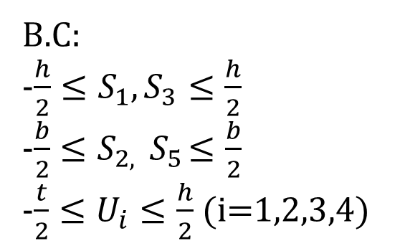
Thin walled beam box element
y
n2
B.C:
-$\frac{h}{2}≤S_{1},S_{3}≤\frac{h}{2}$
-$\frac{b}{2}≤S_{2,}{ S}_{5}≤\frac{b}{2}$
-$\frac{t}{2}≤U_{i}≤\frac{h}{2}$ (i=1,2,3,4)
x
s1
s2
n1
n3
s3
t
s4
z
h
n4
b

Slide 3
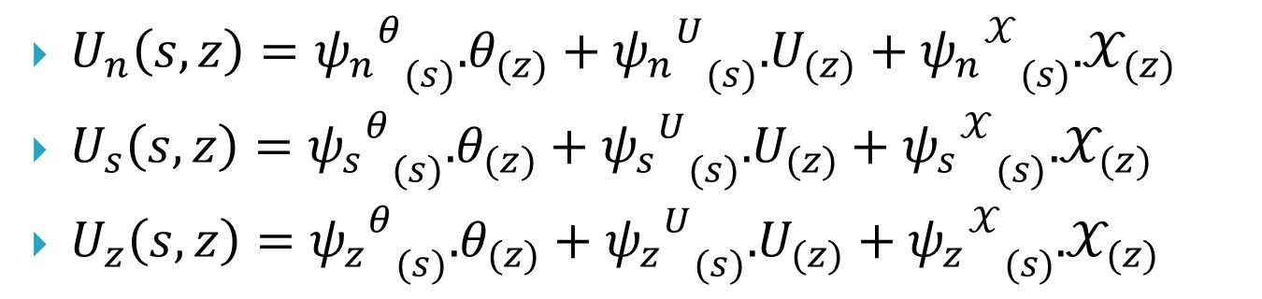

Displacements
$U_{n}\left(s,z\right)={{ψ_{n}}^{θ}}_{(s)}$.$θ_{(z)}+{{ψ_{n}}^{U}}_{(s)}$.$U_{(z)}+{{ψ_{n}}^{𝒳}}_{(s)}$.$𝒳_{(z)}$
$U_{s}\left(s,z\right)={{ψ_{s}}^{θ}}_{(s)}$.$θ_{(z)}+{{ψ_{s}}^{U}}_{(s)}$.$U_{(z)}+{{ψ_{s}}^{𝒳}}_{(s)}$.$𝒳_{(z)}$
$U_{z}\left(s,z\right)={{ψ_{z}}^{θ}}_{(s)}$.$θ_{(z)}+{{ψ_{z}}^{U}}_{(s)}$.$U_{(z)}+{{ψ_{z}}^{𝒳}}_{(s)}$.$𝒳_{(z)}$
$$θ$$
Rotation
Warping
Distorsion

Slide 4

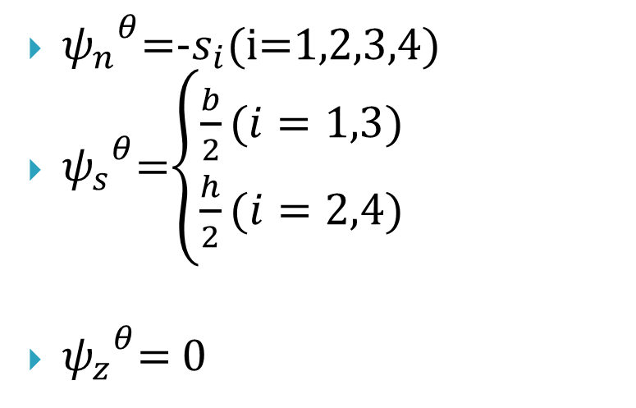
Rotation
$$θ$$
${ψ_{n}}^{θ}$=-$s_{i}$(i=1,2,3,4)
${ψ_{s}}^{θ}$=$\left\{\begin{aligned}\frac{b}{2}(i=1,3) \\ \frac{h}{2}(i=2,4)\end{aligned}\right.$
${ψ_{z}}^{θ}$= 0
Rotation

Slide 5
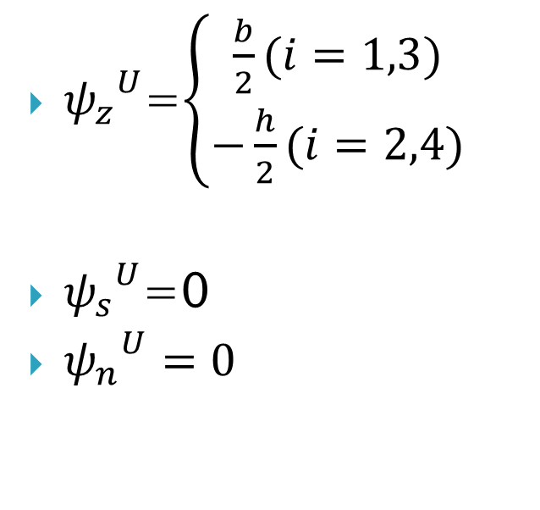
Warping
${ψ_{z}}^{U}$=$\left\{\begin{aligned}\frac{b}{2}(i=1,3) \\ −\frac{h}{2}(i=2,4)\end{aligned}\right.$
${ψ_{s}}^{U}$=0
${ψ_{n}}^{U}=0$
Warping

Slide 6
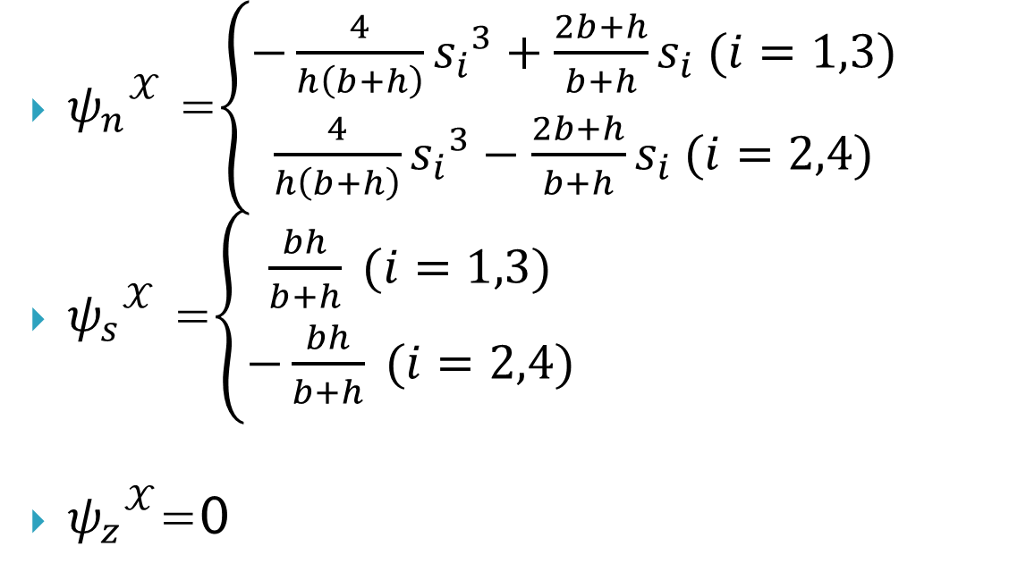
Distorsion
${ψ_{n}}^{𝒳}$ =$\left\{\begin{aligned}−\frac{4}{h\left(b+h\right)}{s_{i}}^{3}+\frac{2b+h}{b+h}s_{i} (i=1,3) \\ \frac{4}{h\left(b+h\right)}{s_{i}}^{3}−\frac{2b+h}{b+h}s_{i} (i=2,4)\end{aligned}\right.$
${ψ_{s}}^{𝒳}$ =$\left\{\begin{aligned}\frac{bh}{b+h} (i=1,3) \\ −\frac{bh}{b+h} (i=2,4)\end{aligned}\right.$
${ψ_{z}}^{𝒳}$=0
Distorsion

Slide 7
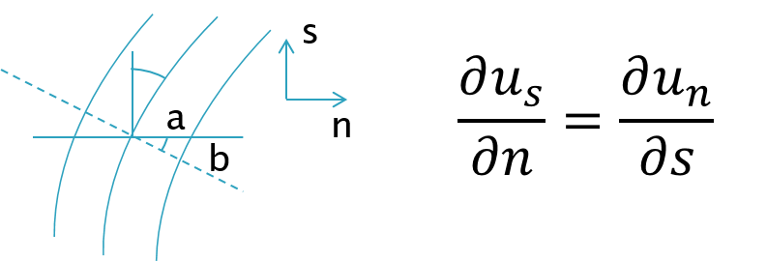
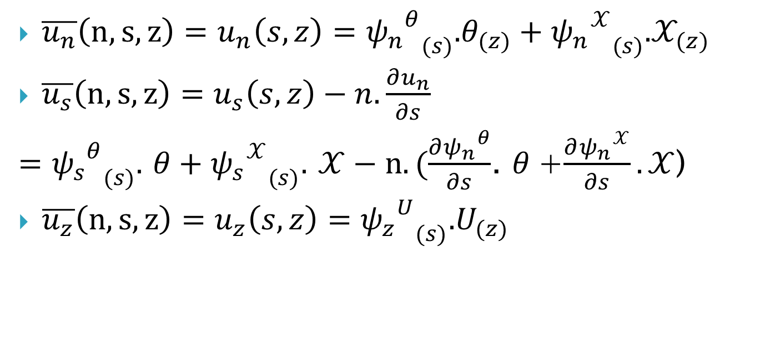
$\overline{u_{n}}\left(n,s,z\right)=u_{n}\left(s,z\right)={{ψ_{n}}^{θ}}_{(s)}$.$θ_{(z)}+{{ψ_{n}}^{𝒳}}_{(s)}$.$𝒳_{(z)}$
$\overline{u_{s}}\left(n,s,z\right)=u_{s}\left(s,z\right)−n.\frac{∂u_{n}}{∂s}$
$={{ψ_{s}}^{θ}}_{(s)}$. $θ+{{ψ_{s}}^{𝒳}}_{(s)}$. $𝒳−n.(\frac{∂{ψ_{n}}^{θ}}{∂s}$. $θ$+$\frac{∂{ψ_{n}}^{𝒳}}{∂s}.𝒳$)
$\overline{u_{z}}\left(n,s,z\right)=u_{z}\left(s,z\right)={{ψ_{z}}^{U}}_{(s)}\text{.}U_{(z)}$

Slide 8




Strain
$ε_{zz}=\frac{∂U_{z}}{∂z}={ψ_{z}}^{U}.U^{′}$
$γ_{zs=}\frac{∂U_{z}}{∂s}+\frac{∂U_{s}}{∂z}$
$=\frac{∂{ψ_{z}}^{U}}{∂s}.U+{ψ_{s}}^{θ}.θ^{′}+{ψ_{s}}^{𝒳}.𝒳^{′}−n.\left(\frac{∂{ψ_{n}}^{θ}}{∂s}\text{.} θ^{′}\text{+}\frac{∂{ψ_{n}}^{𝒳}}{∂s}.𝒳^{′}\right)$
$ε_{ss}=\frac{∂U_{s}}{∂s}=−n.\frac{∂^{2}{ψ_{n}}^{𝒳}}{{∂s}^{2}}.𝒳$
$$ε_{ss}$$
$$γ_{zs}$$
$$ε_{zz}$$

Slide 9

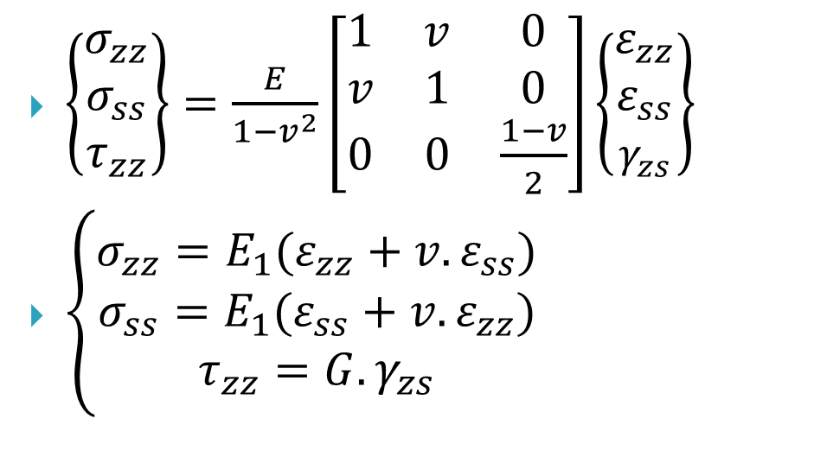


Stress
$\left\{\begin{aligned}σ_{zz} \\ σ_{ss} \\ τ_{zz}\end{aligned}\right\}=\frac{E}{1−v^{2}}\left[\begin{matrix}1 & v & 0 \\ v & 1 & 0 \\ 0 & 0 & \frac{1−v}{2}\end{matrix}\right]\left\{\begin{aligned}ε_{zz} \\ ε_{ss} \\ γ_{zs}\end{aligned}\right\}$
$\left\{\begin{aligned}σ_{zz}=E_{1}(ε_{zz}+v.ε_{ss}) \\ \begin{aligned}σ_{ss}=E_{1}(ε_{ss}+v.ε_{zz}) \\ τ_{zz}=G.γ_{zs}\end{aligned}\end{aligned}\right.$
$$σ_{ss}$$
$$τ_{zs}$$
$$σ_{zz}$$

Slide 10
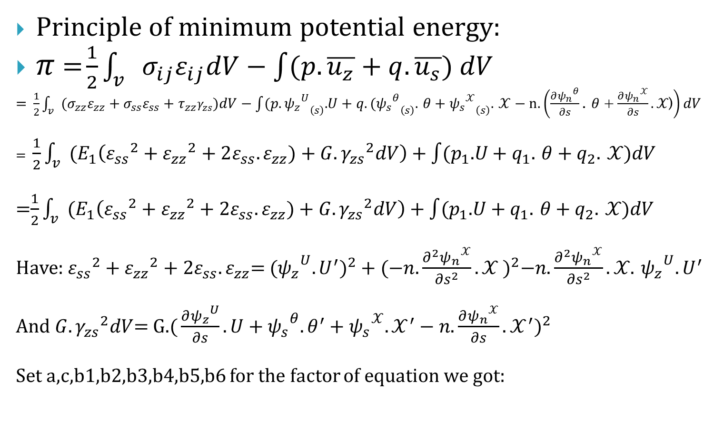
Principle of minimum potential energy:
$π$ = $\frac{1}{2}\int_{v}{{σ_{ij}ε}_{ij}dV−\int{(p.\overline{u_{z}}+q.\overline{u_{s}}) dV}}$
= $\frac{1}{2}\int_{v}{{{(σ}_{zz}ε}_{zz}+{σ_{ss}ε}_{ss}+τ_{zz}γ_{zs})dV−\int{(p.{{ψ_{z}}^{U}}_{\left(s\right)}\text{.}U+q.({{ψ_{s}}^{θ}}_{\left(s\right)}\text{.} θ+{{ψ_{s}}^{𝒳}}_{\left(s\right)}\text{.} 𝒳−n.\left(\frac{∂{ψ_{n}}^{θ}}{∂s}\text{.} θ \text{+}\frac{∂{ψ_{n}}^{𝒳}}{∂s}.𝒳\text{)}\right)dV}}$
= $\frac{1}{2}\int_{v}{(E_{1}\left({ε_{ss}}^{2}+{ε_{zz}}^{2}+2ε_{ss}.ε_{zz})+G.{γ_{zs}}^{2}dV\right)}$ +$\int{(p_{1}\text{.}U+q_{1}\text{.} θ+q_{2}\text{.} 𝒳)dV}$
=$\frac{1}{2}\int_{v}{(E_{1}\left({ε_{ss}}^{2}+{ε_{zz}}^{2}+2ε_{ss}.ε_{zz})+G.{γ_{zs}}^{2}dV\right)}$ +$\int{(p_{1}\text{.}U+q_{1}\text{.} θ+q_{2}\text{.} 𝒳)dV}$
Have: ${ε_{ss}}^{2}+{ε_{zz}}^{2}+2ε_{ss}.ε_{zz}$= (${{ψ_{z}}^{U}.U^{′})}^{2}+{(−n.\frac{∂^{2}{ψ_{n}}^{𝒳}}{{∂s}^{2}}.𝒳 )}^{2}−n.\frac{∂^{2}{ψ_{n}}^{𝒳}}{{∂s}^{2}}.𝒳$. ${ψ_{z}}^{U}.U^{′}$
And $G.{γ_{zs}}^{2}dV$= G.${\text{(}\frac{∂{ψ_{z}}^{U}}{∂s}.U+{ψ_{s}}^{θ}.θ^{′}+{ψ_{s}}^{𝒳}.𝒳^{′}−n.\frac{∂{ψ_{n}}^{𝒳}}{∂s}.𝒳^{′})}^{2}$
Set a,c,b1,b2,b3,b4,b5,b6 for the factor of equation we got:

Slide 11
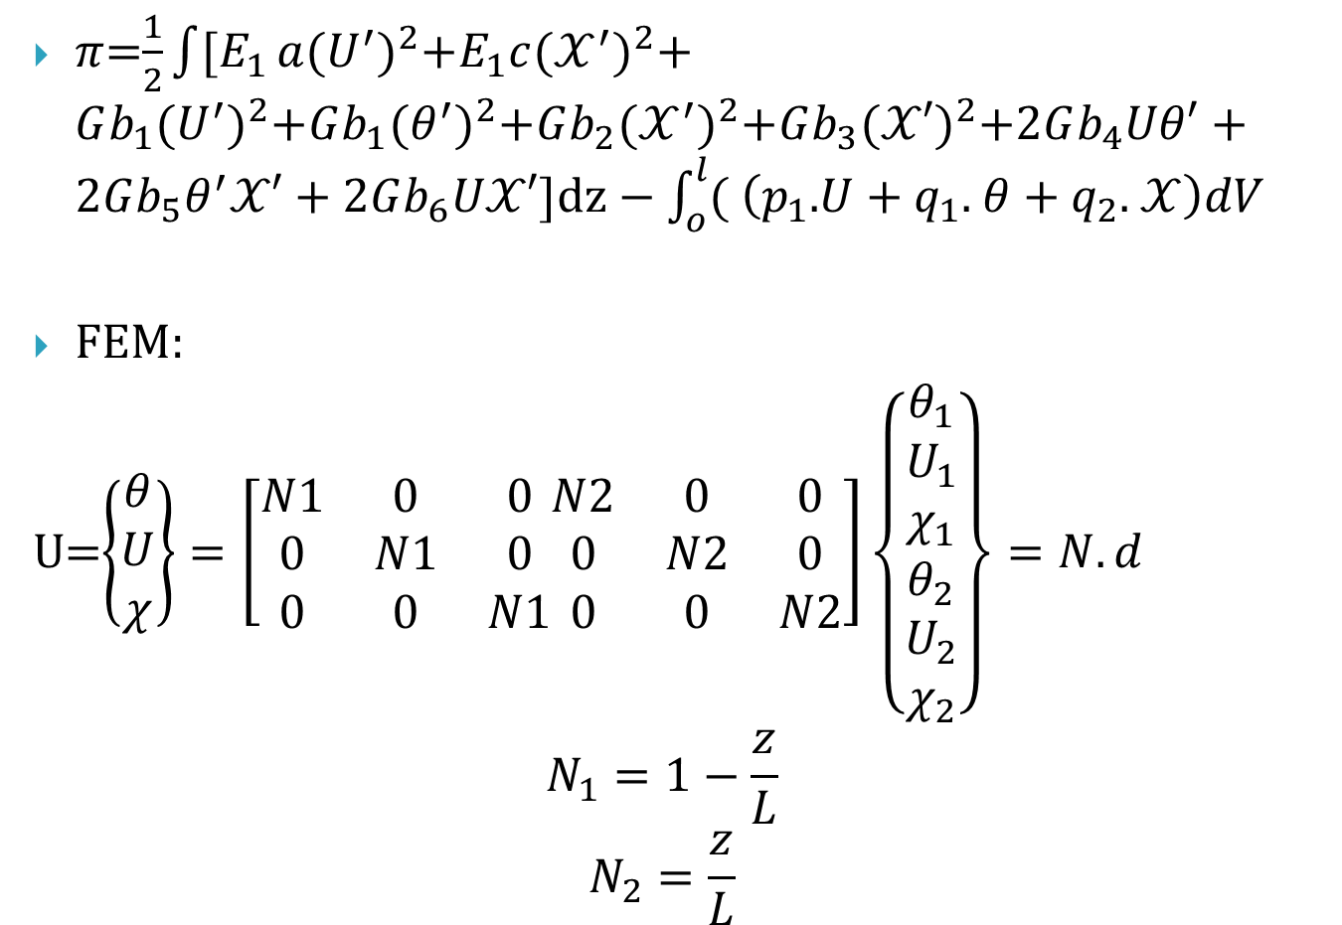
$π$=$\frac{1}{2}\int{[E_{1}}a{(U^{′})}^{2}+E_{1}c{(𝒳^{′})}^{2}$+$Gb_{1}{(U^{′})}^{2}+Gb_{1}{(θ^{′})}^{2}+Gb_{2}{(𝒳^{′})}^{2}+Gb_{3}{(𝒳′)}^{2}+2Gb_{4}Uθ′+2Gb_{5}θ^{′}𝒳′$ + $2Gb_{6}U𝒳′]dz−\int_{o}^{l}{(}$ $\left(p_{1}\text{.}U+q_{1}\text{.} θ+q_{2}\text{.} 𝒳\right)dV$
FEM:
U=$\left\{\begin{aligned}θ \\ U \\ χ\end{aligned}\right\}=\left[\begin{matrix}N1 & 0 & 0 \\ 0 & N1 & 0 \\ 0 & 0 & N1\end{matrix}\begin{matrix}N2 & 0 & 0 \\ 0 & N2 & 0 \\ 0 & 0 & N2\end{matrix}\right]\left\{\begin{aligned}θ_{1} \\ U_{1} \\ χ_{1} \\ \begin{aligned}θ_{2} \\ U_{2} \\ χ_{2}\end{aligned}\end{aligned}\right\}=N.d$
$$N_{1}=1−\frac{z}{L}$$
$$N_{2}=\frac{z}{L}$$

Slide 12
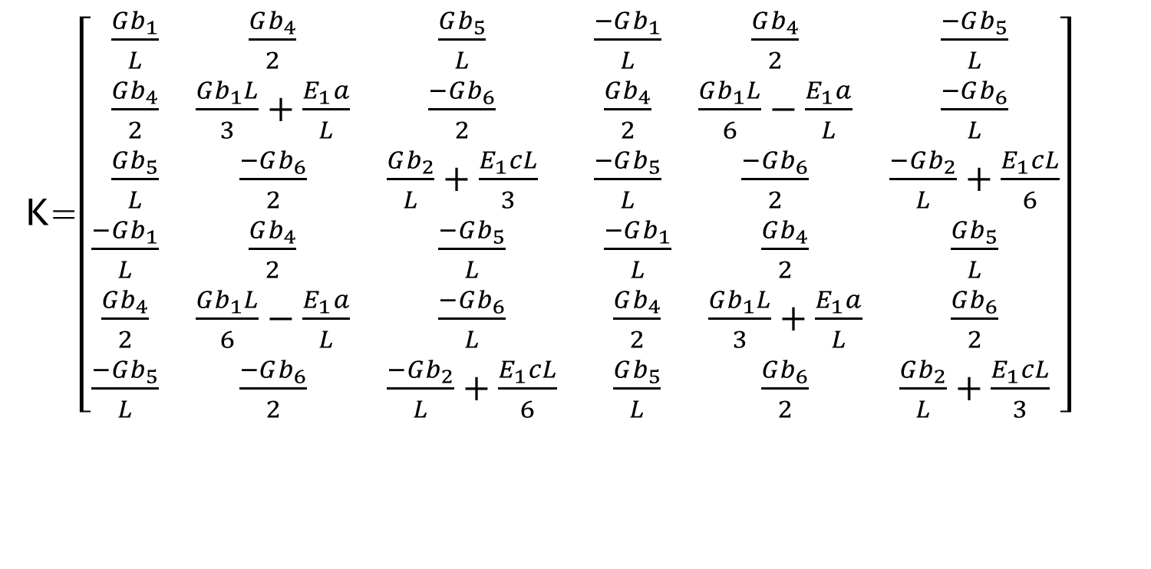
Stiffness matrix
K=$\left[\begin{matrix}\begin{matrix}\frac{Gb_{1}}{L} & \frac{Gb_{4}}{2} & \frac{Gb_{5}}{L} \\ \frac{Gb_{4}}{2} & \frac{Gb_{1}L}{3}+\frac{E_{1}a}{L} & \frac{−Gb_{6}}{2} \\ \frac{Gb_{5}}{L} & \frac{−Gb_{6}}{2} & \frac{Gb_{2}}{L}+\frac{E_{1}cL}{3}\end{matrix} & \begin{matrix}\frac{−Gb_{1}}{L} & \frac{Gb_{4}}{2} & \frac{−Gb_{5}}{L} \\ \frac{Gb_{4}}{2} & \frac{Gb_{1}L}{6}−\frac{E_{1}a}{L} & \frac{−Gb_{6}}{L} \\ \frac{−Gb_{5}}{L} & \frac{−Gb_{6}}{2} & \frac{−Gb_{2}}{L}+\frac{E_{1}cL}{6}\end{matrix} \\ \begin{matrix}\frac{−Gb_{1}}{L} & \frac{Gb_{4}}{2} & \frac{−Gb_{5}}{L} \\ \frac{Gb_{4}}{2} & \frac{Gb_{1}L}{6}−\frac{E_{1}a}{L} & \frac{−Gb_{6}}{L} \\ \frac{−Gb_{5}}{L} & \frac{−Gb_{6}}{2} & \frac{−Gb_{2}}{L}+\frac{E_{1}cL}{6}\end{matrix} & \begin{matrix}\frac{−Gb_{1}}{L} & \frac{Gb_{4}}{2} & \frac{Gb_{5}}{L} \\ \frac{Gb_{4}}{2} & \frac{Gb_{1}L}{3}+\frac{E_{1}a}{L} & \frac{Gb_{6}}{2} \\ \frac{Gb_{5}}{L} & \frac{Gb_{6}}{2} & \frac{Gb_{2}}{L}+\frac{E_{1}cL}{3}\end{matrix}\end{matrix}\right]$

Slide 13
Going to do in next week:
Finish the examples in paper 1999
Read paper:
“Exact Matching Condition at a Joint of Thin Walled Box Beams Under Out-of-Plane Bending and Torsion”

